Slide 1
Supply Chain Management Project
KPIs, Inventory, Sales & Decision Analytics
Group No : 6
Group Member Details:
1.Rahul Kumar R
2.Shivam Sharma
3.Preethu G R
4.Keerthiga N C
5.Tushar Rajgure
6.Chetana Dable
7.Yogita Shinde
8.Mohammed yaseen

Slide 2
Introduction
Domain: Supply Chain Management & Analytics.
Focus on sales, inventory, and regional performance.
Goal: Support data-driven decision making using dashboards.
Description : This project analyzes sales and inventory data to monitor key supply chain performance indicators such as MTD, QTD, YTD sales, product-wise performance, inventory levels, and stock status. Interactive dashboards were created using Excel, SQL, Power BI, and Tableau to identify demand trends, regional performance, and inventory imbalances, enabling data-driven decision-making and improved supply chain efficiency.

Slide 3
Tools & Technologies
Excel – Data cleaning & KPI calculations
SQL – Data extraction & transformations
Power BI – Interactive dashboards & KPIs
Tableau – Supply chain visual analytics
Sales Performance KPIs
Total Sales: MTD, QTD, YTD
Product-wise Sales Analysis
Sales Growth (MoM / YoY)
Daily Sales Trend Analysis
Top 5 Stores by Sales

Slide 4
Inventory Management KPIs
Total Inventory Available
Inventory Value
Stock Status: In-stock, Under-stock, Out-of-stock
Warehouse / Location-wise Inventory
Regional & Store KPIs
State-wise Sales Performance
Region-wise Sales Trends
Store-wise Contribution Analysis
Identification of High & Low Performing Regions

Slide 5
Purchase & Demand KPIs
Purchase Method-wise Sales (Online, In-store, Cash, Card)
Demand vs Supply Analysis
Stock Replenishment Indicators
Key Insights
High-performing products and regions identified
Inventory imbalance impacts sales performance
Out-of-stock situations lead to missed sales
Dashboards improve operational visibility

Slide 6
Challenges
Managing large supply chain datasets
Maintaining inventory accuracy
Integrating data from multiple sources
Designing meaningful KPIs

Slide 7
Conclusion
Supply chain KPIs help optimize inventory and sales
Data-driven decisions improve efficiency
Project demonstrates practical SCM analytics skills

Slide 8
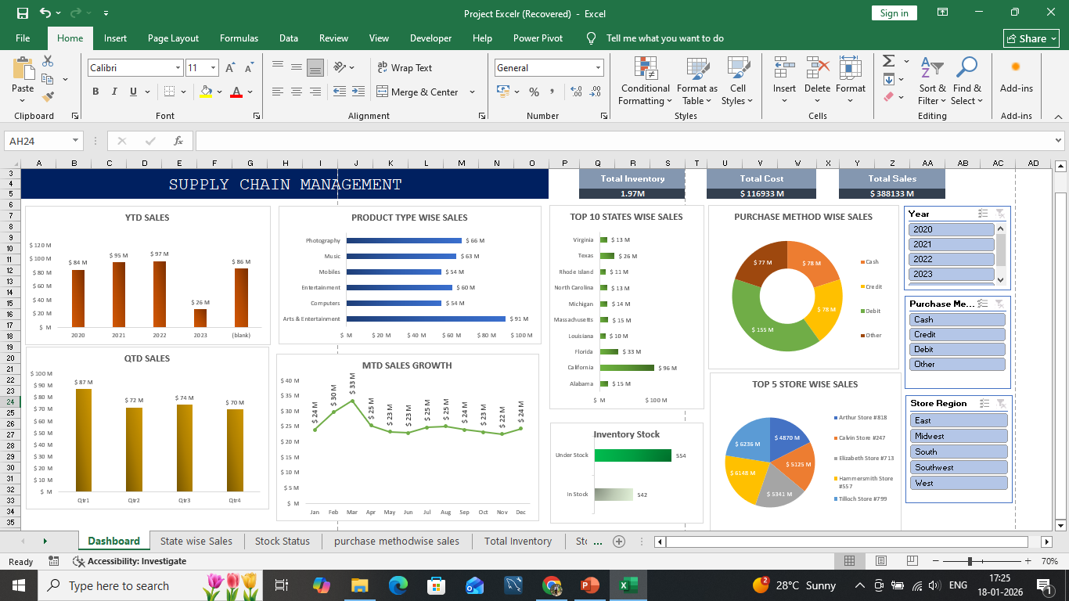
Excel Dashboard

Slide 9
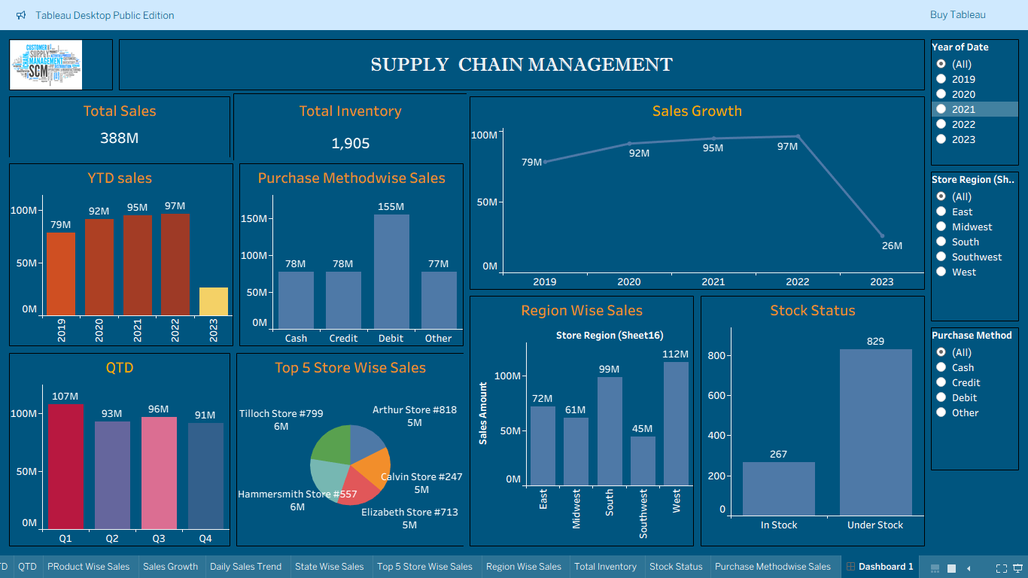
Tableau Dashboard

Slide 10
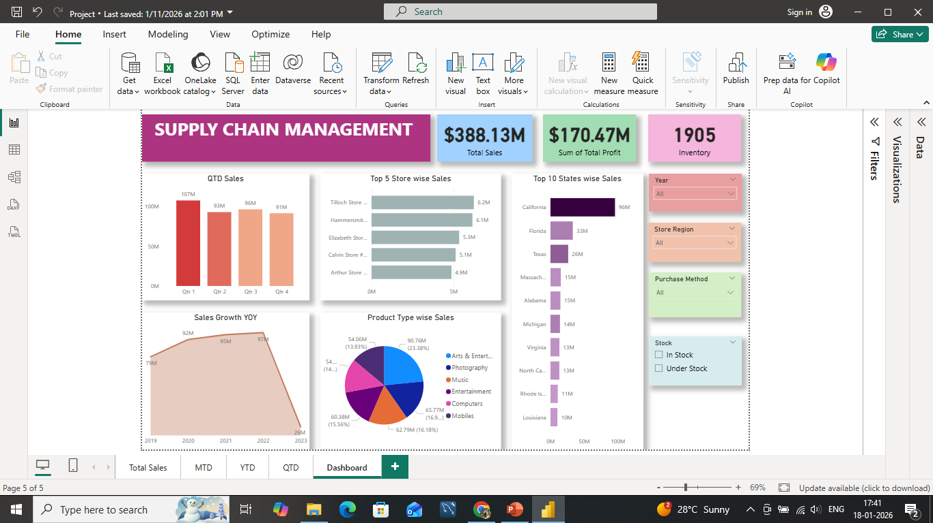
Power BI Dashboard

Slide 11
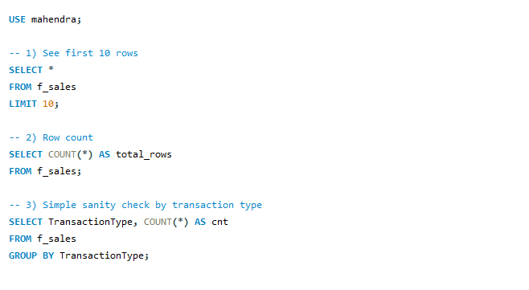
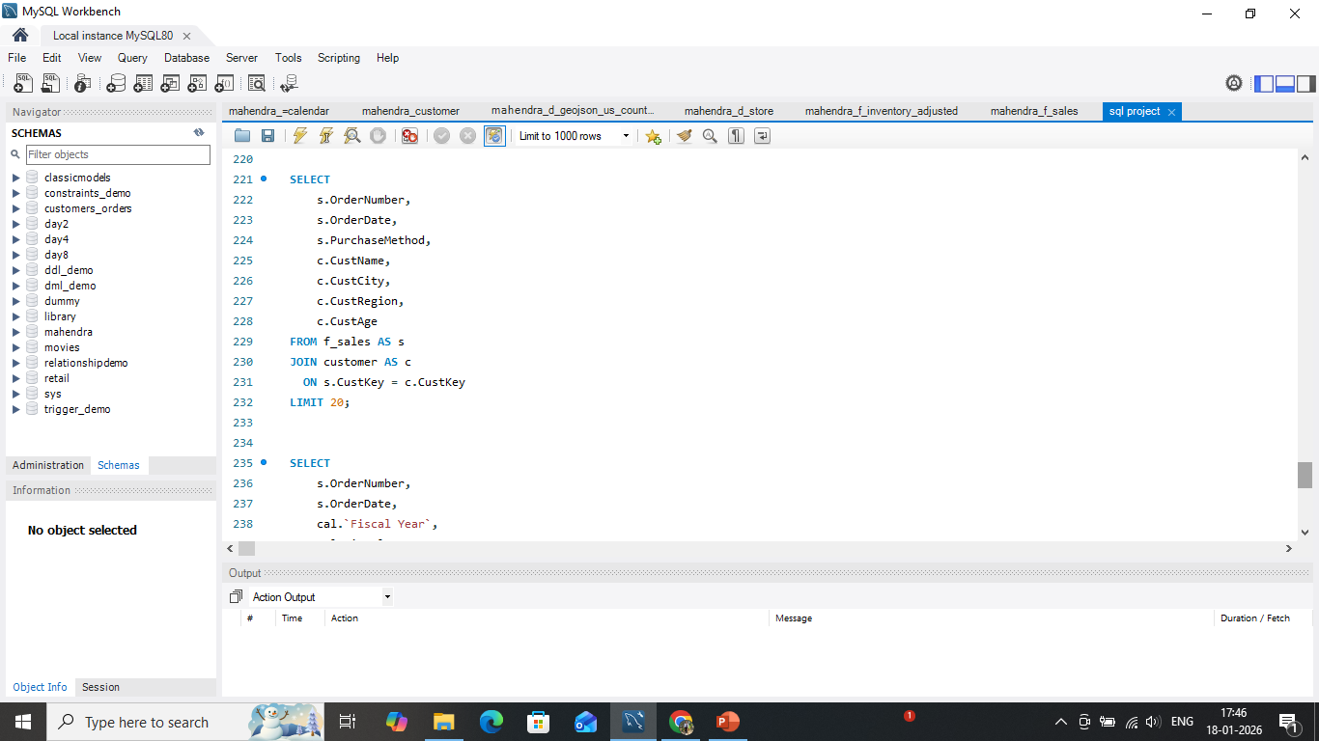
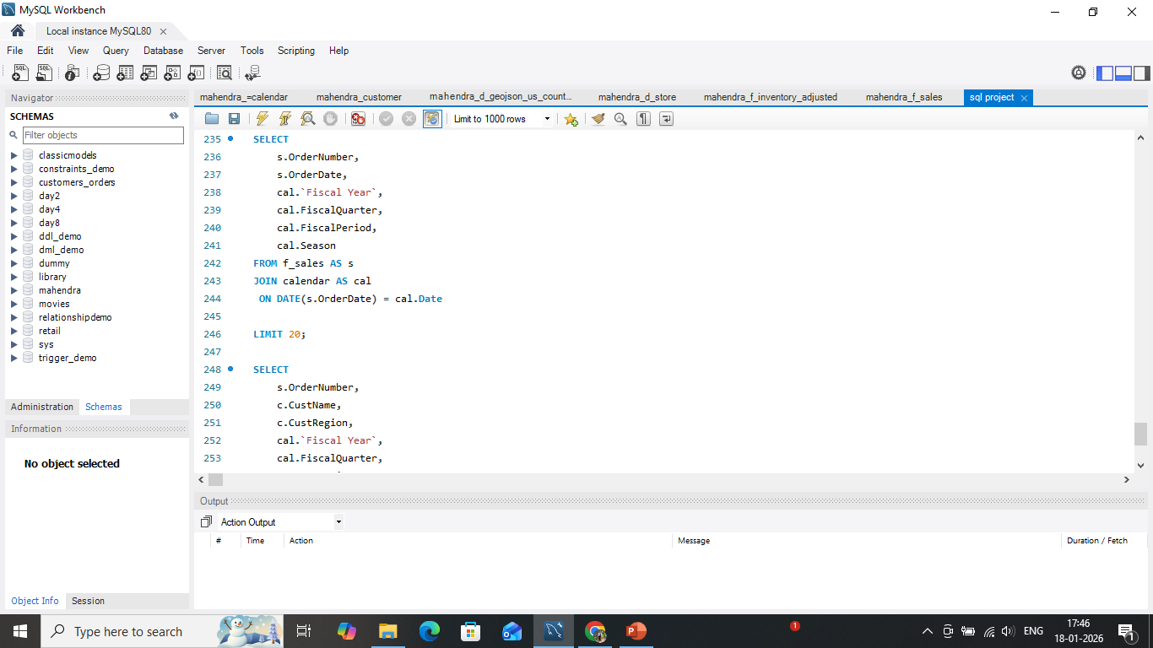
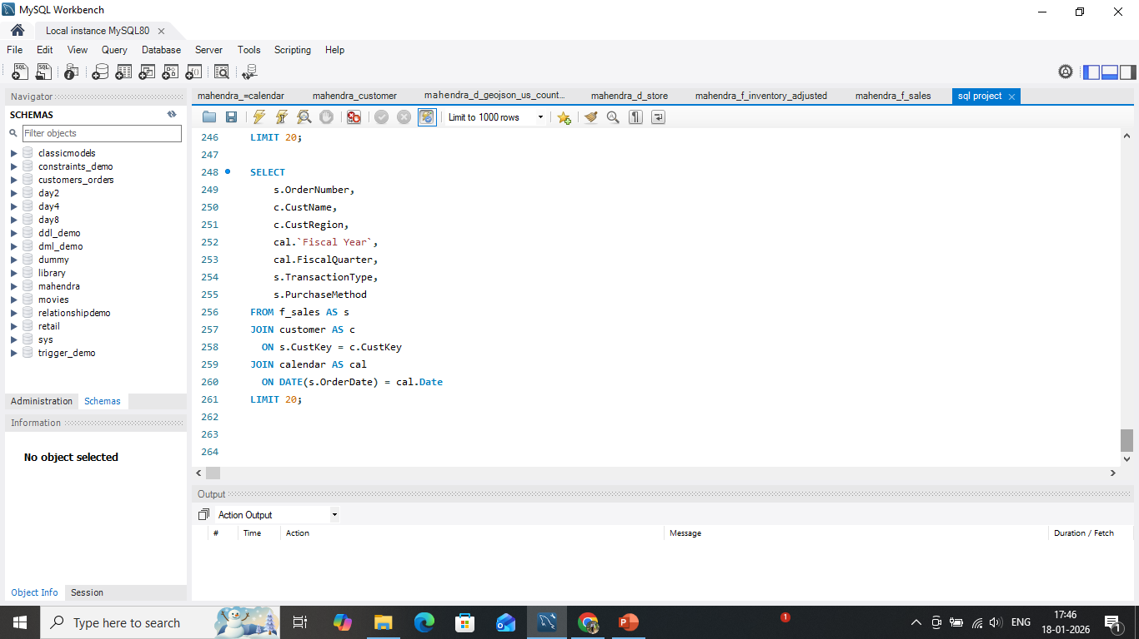
SQL

Slide 12
Thank You

